Slide 1
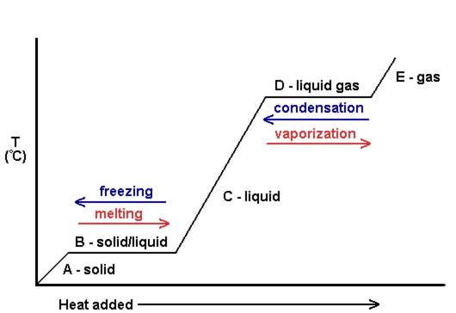
Phase Change Graph
Julia Schoenewald

Slide 2
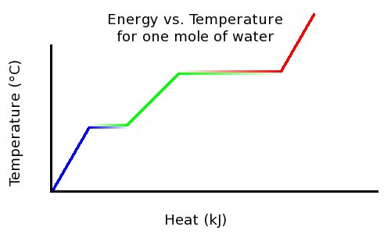
Explanation: page 403
Picture: page 523
Kinetic Energy is added to a liquid causing the temperature to rise
Eventually a phase change occurs and you observe a plateau
During a phase change the temperature remains constant
Phase changes include melting, freezing, evaporation, and condensation

Slide 3
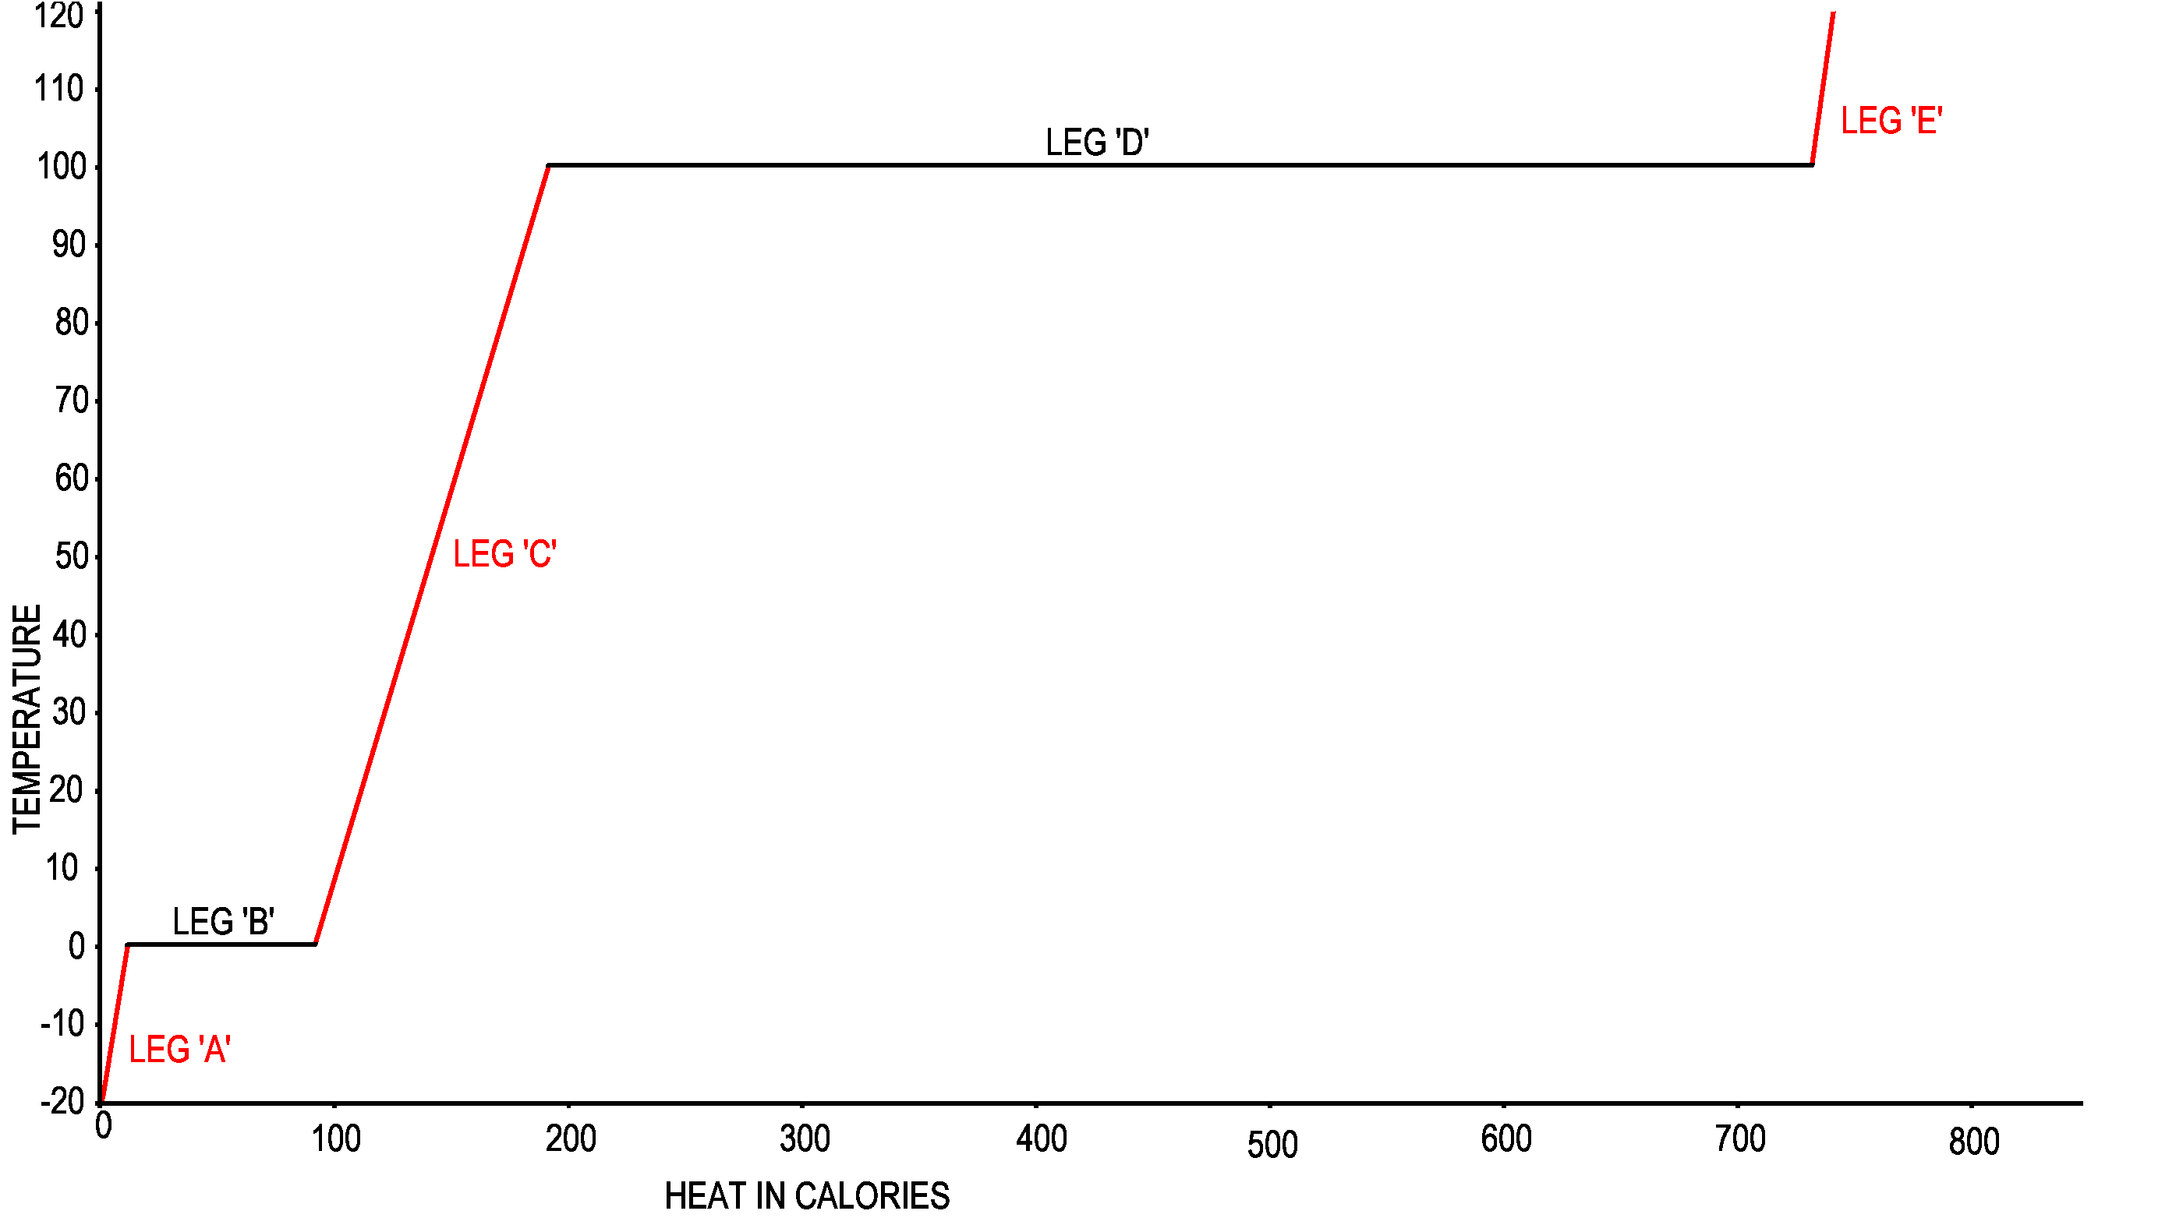
Where does the diagram first plateau and why?
What is happening to the kinetic energy in Leg C?
Where does the diagram plateau again and why?

Slide 4
Answers
It plateaus at 0⁰C because a phase change is a occurring. Either freezing or melting is happening at this temperature. During a phase change the temperature doesn’t change.
During Leg C more kinetic energy is being added to the liquid causing the temperature to rise.
It plateaus at 100⁰C because there is a phase change. Evaporation or condensation is occurring at this temperature. During a phase change the temperature doesn’t change.

Slide 5
 | From | To | Name | Energy
Leg B (A→C)
Leg B (C→A)
Leg D (C→E)
Leg D (E→C)

Slide 6
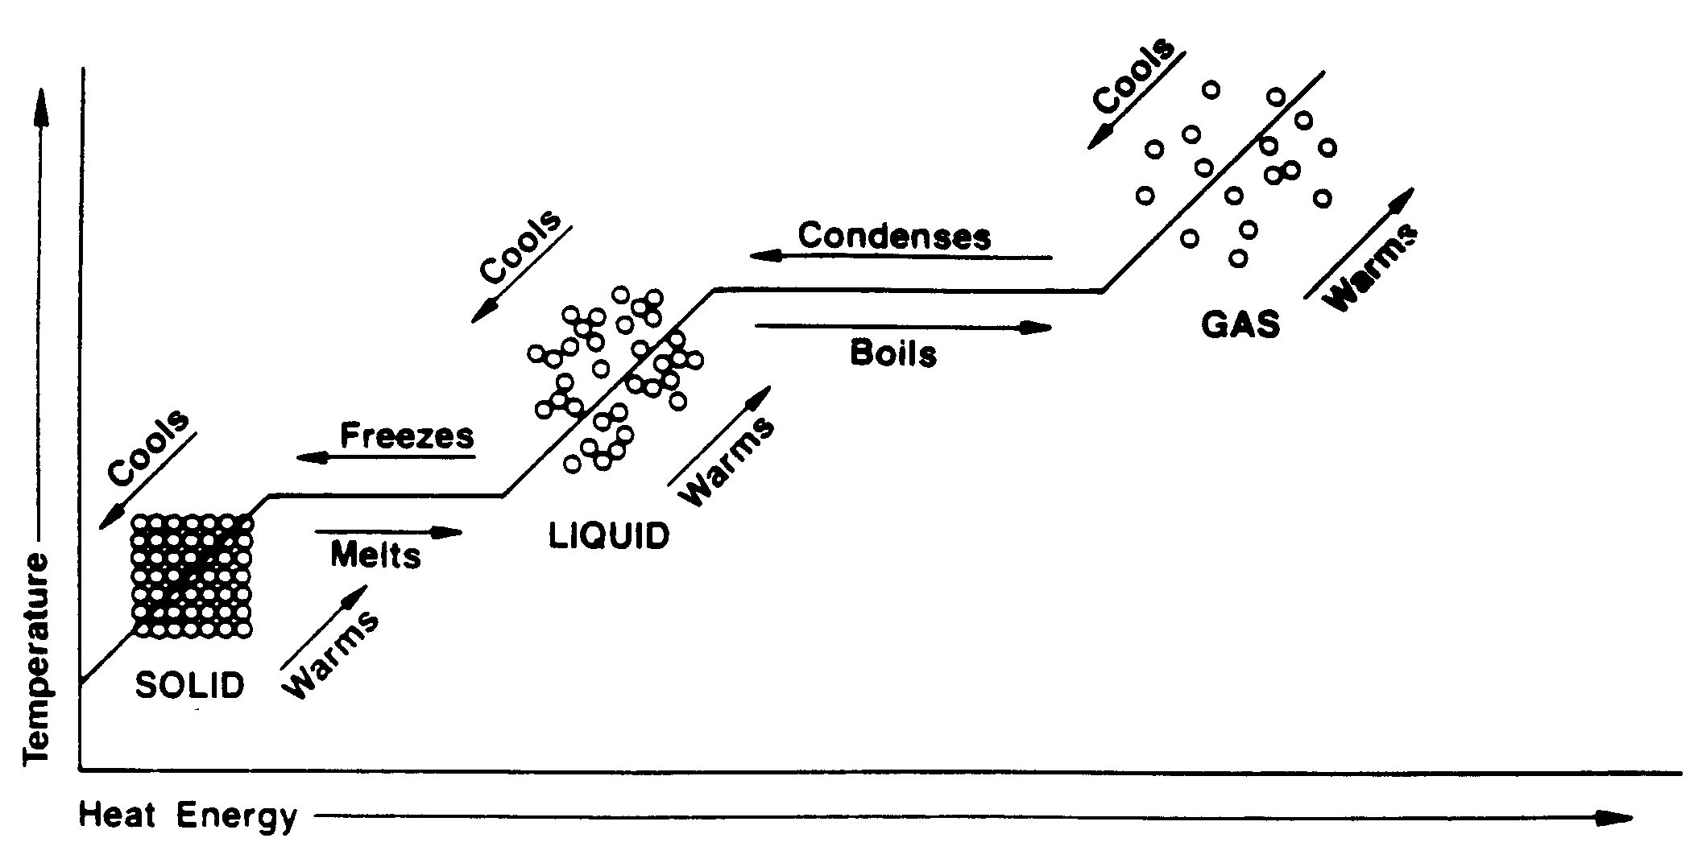
Phase Changes
 | From | To | Name | Energy
Leg B (A→C) | solid | liquid | melting | rising
Leg B (C→A) | liquid | gas | evaporation | rising
Leg B (C→E) | gas | liquid | condensation | falling
Leg B (E→C) | liquid | solid | freezing | falling

